Slide 1
Another Bayesian package?

Slide 2
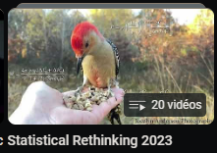

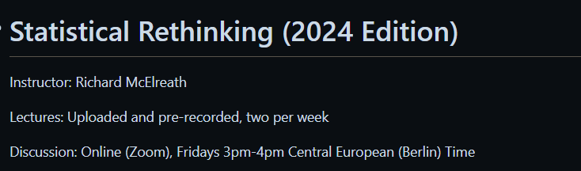
Learning process
September
November
January
WIP

Slide 3
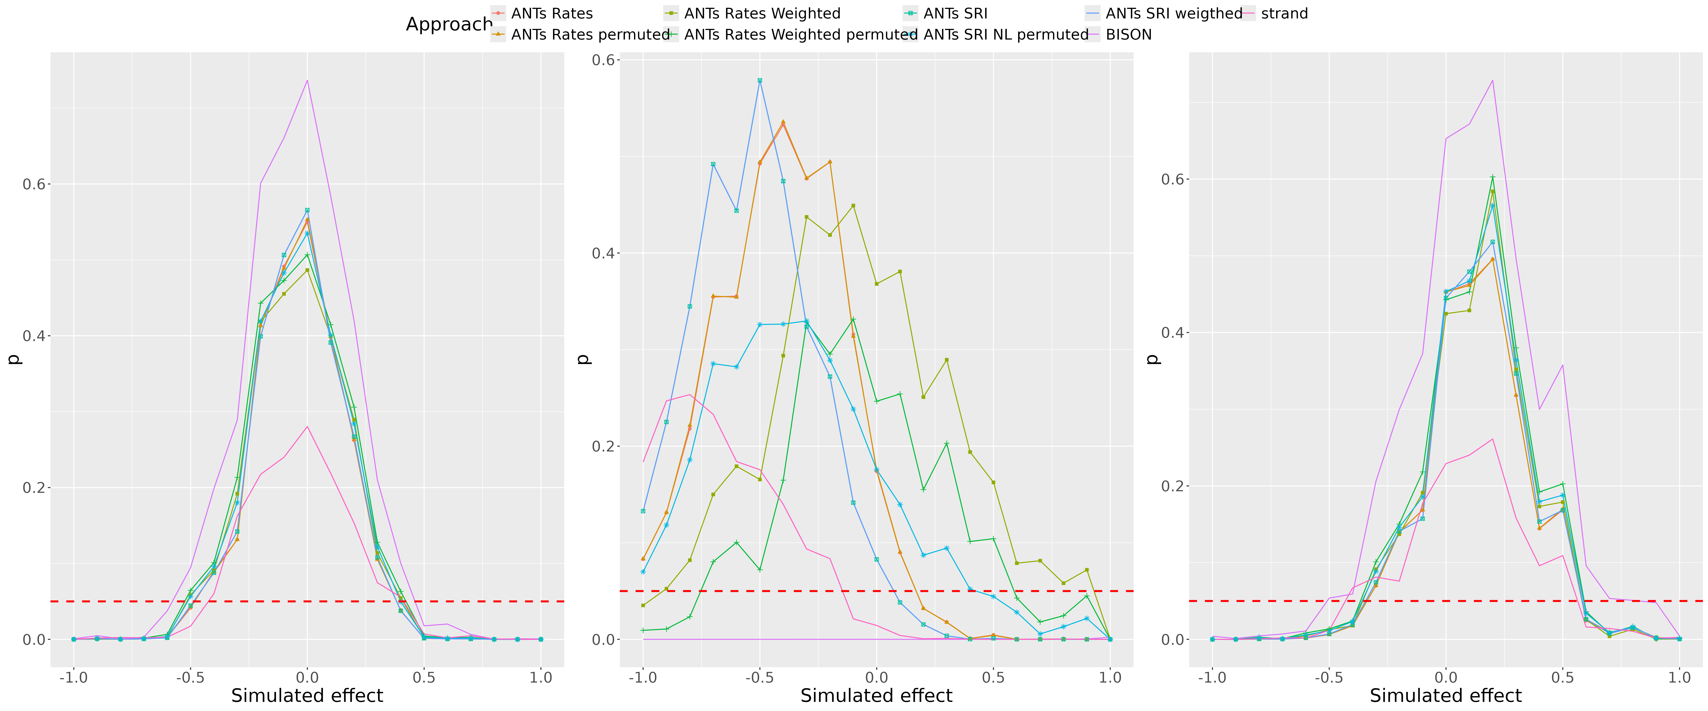
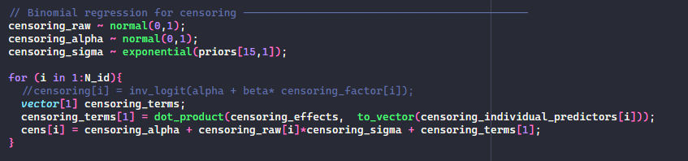
Work in progress 1

Slide 4
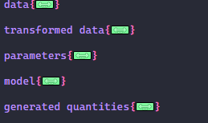
Work in progress 2

Slide 5
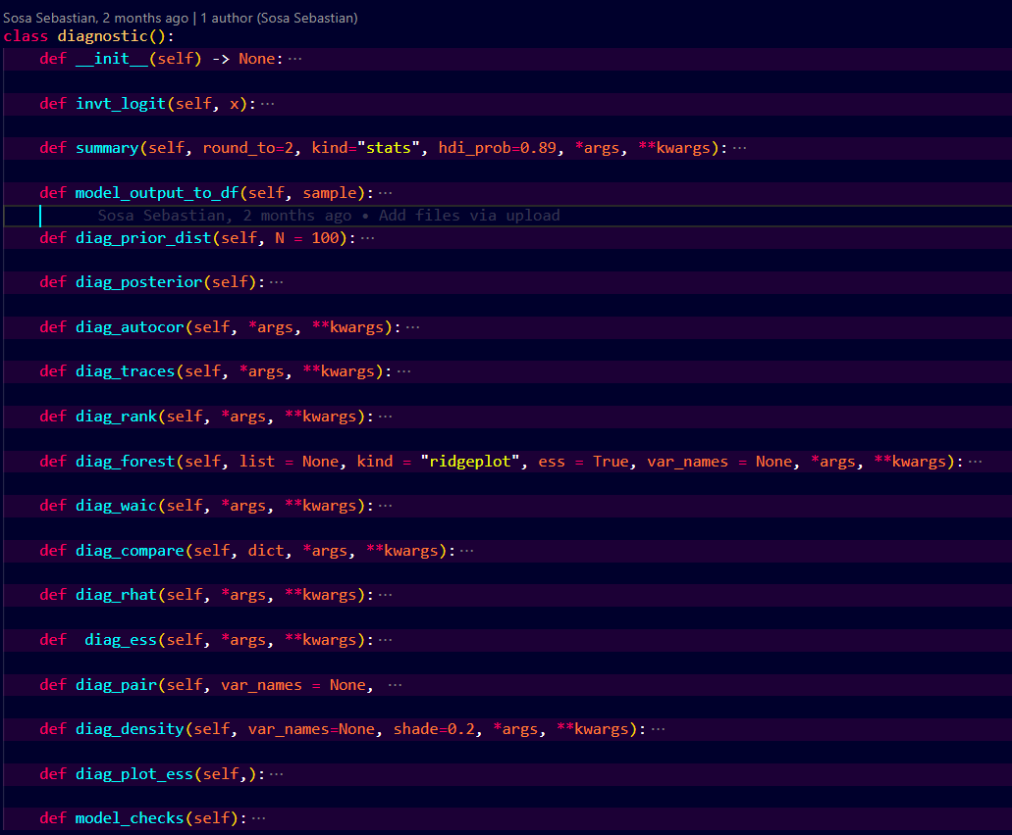
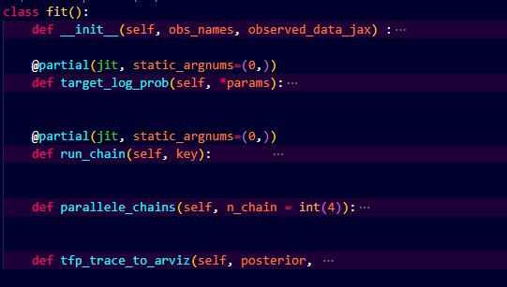
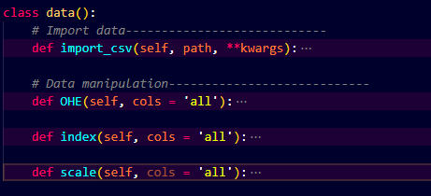
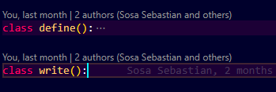
Bayesian Inference package WIP 2
Data manipulation
Model definition & building
Parameter optimization
Diagnostics

Slide 6
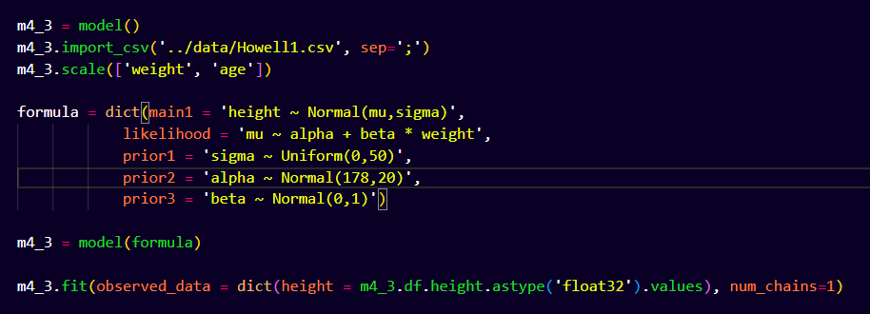
Model template

Slide 7
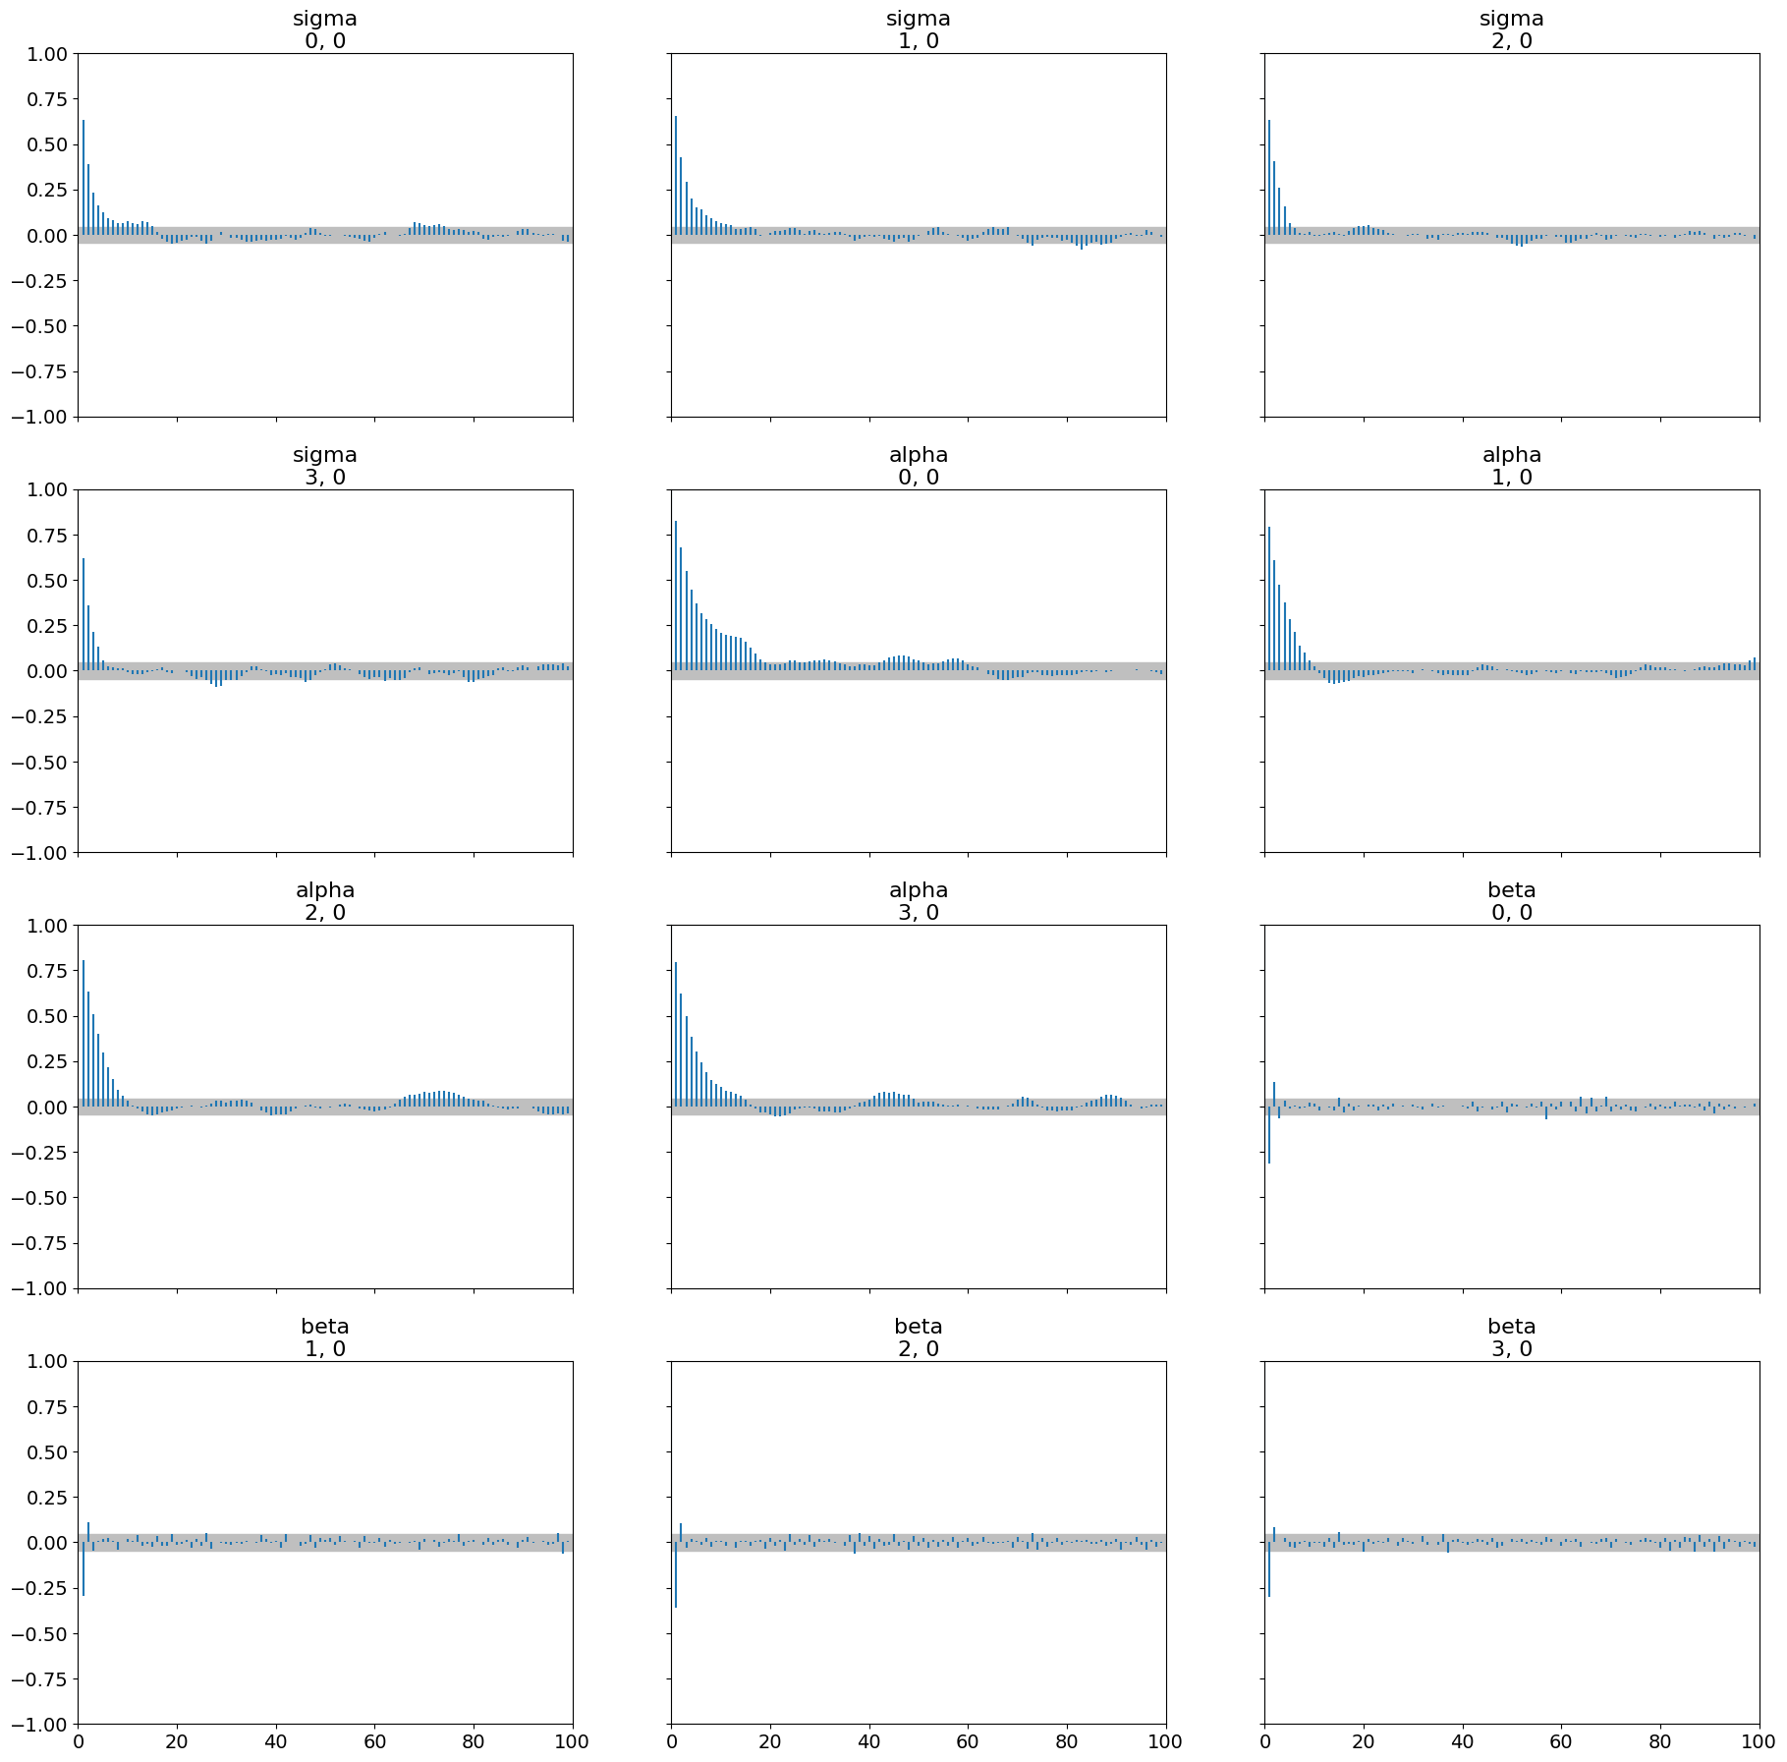
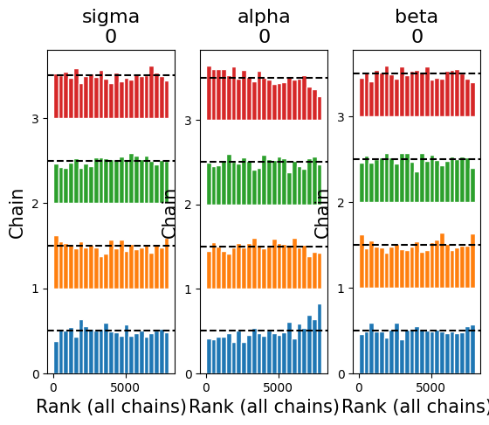
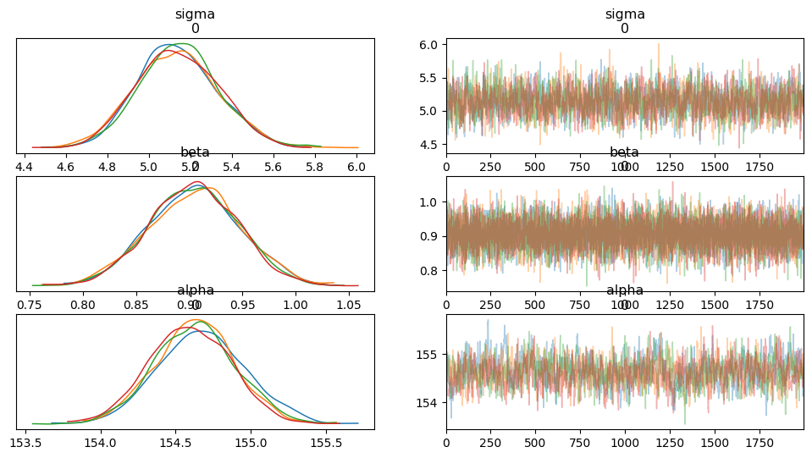
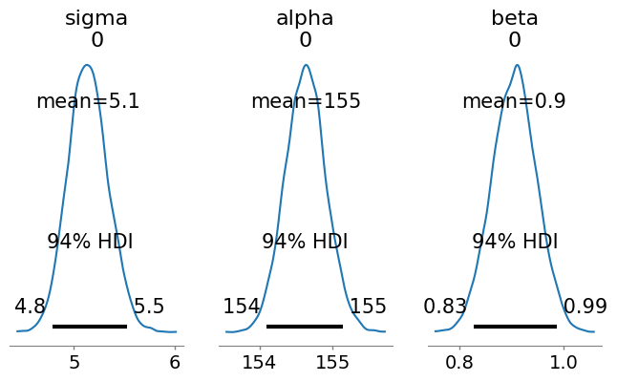
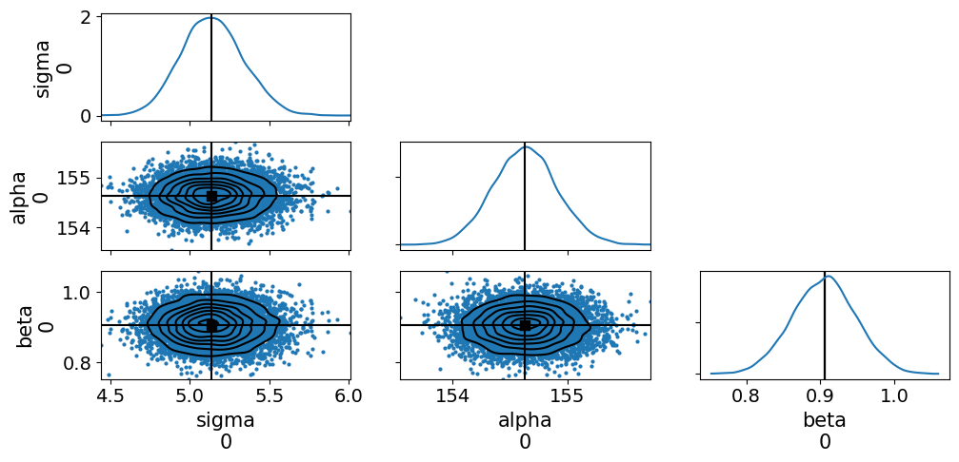
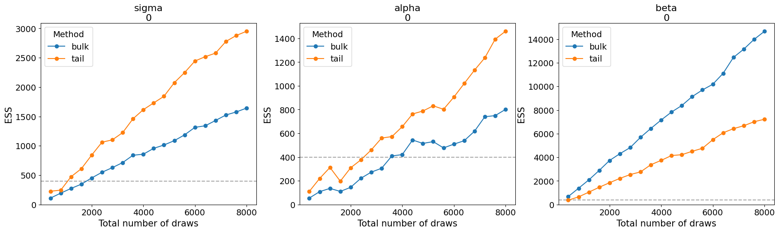
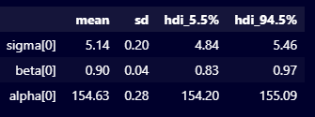
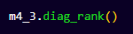
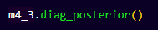
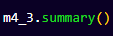
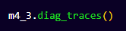
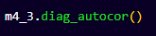
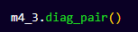
Model Diagnostic
Matrix of scatter plots, kernel density estimation, and marginal plots
Rank order statistics of chains
Posterior distribution
Posterior summary
Trace plot
Auto-correlation
Evolution ESS plots
Model comparison

Slide 8



Under the wood
Data manipulation
Model definition and building
Parameter optimization
Diagnostic

Slide 9
Why tensorflow probability (TFP) ?
Probabilistic Modeling
Bayesian Inference on
Structured Probabilistic Models
Integration with Other Libraries
TFP
Probabilistic Layers
High Performance
Integration with TensorFlow
Scalability
Flexibility
Notes:
Probabilistic Modeling: Tools for probabilistic modeling, enabling users to express uncertainty and model complex, real-world phenomena more accurately.
Bayesian Inference on Structured Probabilistic Models: TFP provides support for Bayesian inference techniques, allowing users to perform probabilistic inference, parameter estimation, and uncertainty quantification in a principled manner. TFP enables the construction of structured probabilistic models, such as Bayesian neural networks, Gaussian processes, and hierarchical models, allowing users to capture dependencies and relationships in their data effectively
High Performance: TensorFlow is optimized for high performance, with features such as automatic differentiation, GPU acceleration, and support for distributed computing, ensuring efficient execution of complex computational graphs.
Scalability and Performance: TFP is designed for scalability and high performance, with support for parallel computation, GPU acceleration, and distributed computing, enabling efficient inference in large-scale probabilistic models. So the same code can be deploy across multiple support CPUs, GPUs, TPU, it can be distributed.
Flexibility: It offers a flexible architecture that enables easy deployment across various platforms, including mobile devices, browsers, and servers.
Integration with TensorFlow: TFP seamlessly integrates with TensorFlow, leveraging its computational graph and automatic differentiation capabilities for efficient and scalable probabilistic inference.
Probabilistic Layers: TFP extends TensorFlow's neural network capabilities with probabilistic layers, allowing users to build neural networks that output probability distributions rather than deterministic predictions, facilitating uncertainty-aware predictions.
Integration with Other Libraries: TensorFlow seamlessly integrates with other popular libraries and frameworks like Keras, scikit-learn, and OpenCV, allowing users to leverage their existing knowledge and workflows.

Slide 10
Validation : testing different models
Continuous variable: Model (model 4.3)
Categorical variable: Model (model 5.9)
Continuous interactions terms (model 8.3)
Binomial (model 11.1)
Binomial with indices (model 11.4)
Poisson (model 11.10)
Negative binomial (model 11.12)
Multinomial (m11.13, m11.14)
Beta binomial (model m12.1)
Zero inflated outcomes (model m12.13, m12.14)
Ordered categorical outcomes
Ordered categorical predictors
Varying interceps (model m13.2)
Varying effects (model m14.1)
Multiple random effects
Networks
Gaussian process

Slide 11
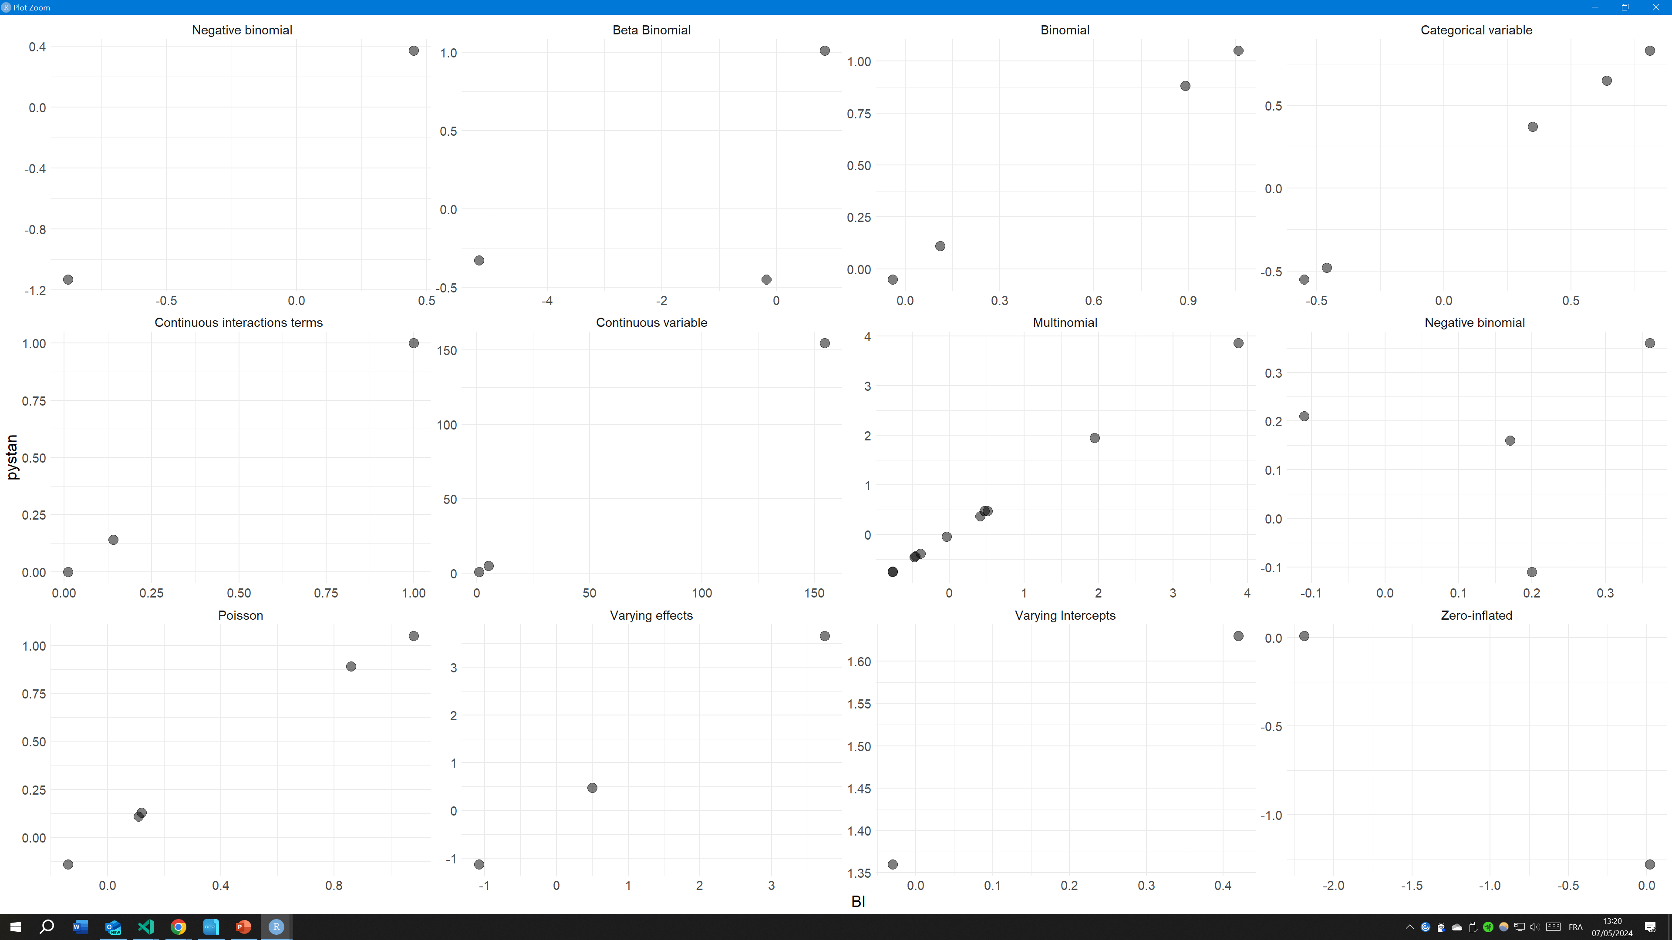
Validation: evaluating models estimations

Slide 12
Validation: Speed comaparison
 | BI v1 | STAN (with compilation) | STAN (without compilation)
Continuous variable | 5.85
Categorical variable | 4.55 | 12,14 | 0,34
Continuous interactions terms | 7.87 | 12,12 | 0,42
Binomial | 3.35 | 10,69 | 0,49
Binomial with indices | 5.22 | 16,53 | 4,73
Poisson | 11.75 | 14,24 | 0,8
Negative binomial | 4.78 | 12,07 | 1,07
Multinomial | 5.26 | 12,79 | 0,59
Beta binomial | 4.26 | 12,89 | 0,49
Negative-binomial
Zero inflated outcomes | 5.2 | 11,52 | 1,32
Varying interceps | 4.96 | 14.19
Varying effects | 13.63 | 30.23
Random variables |  | 27,55 | 3,25

Slide 13

BI V2 :
Why JAX?
Flexible Device Placement
Composable Function Transformations
Mathematical operations
TFP
Ecosystem Integration
Automatic Differentiation
Just-In-Time Compilation
Notes:
Jax allow :
Composable Function Transformations: JAX provides a functional programming model where transformations like automatic differentiation, JIT compilation, and vectorization can be composed, enabling users to build custom transformations efficiently.
Automatic Differentiation: JAX offers automatic differentiation capabilities through its grad function, which allows users to compute gradients of numerical functions with respect to their inputs, crucial for training deep neural networks and optimizing objective functions.
Its strength are:
Just-In-Time (JIT) Compilation: JAX's JIT compiler (jit function) accelerates numerical computations by compiling Python functions into optimized machine code, resulting in significant performance improvements, especially for numerical kernels and tight loops.
Ecosystem Integration: JAX integrates with various libraries and frameworks in the scientific computing and machine learning ecosystems, including TensorFlow, PyTorch, and Flax, enabling interoperability and code reuse across different frameworks.
Flexible Device Placement: JAX offers flexibility in device placement, allowing users to execute computations on CPU, GPU, or TPU devices interchangeably, with minimal changes to their code, which facilitates experimentation and deployment across different hardware platforms.

Slide 14
Validation : testing different models
Continuous variable: Model (model 4.3)
Categorical variable: Model (model 5.9)
Continuous interactions terms (model 8.3)
Binomial (model 11.1)
Binomial with indices (model 11.4)
Poisson (model 11.10)
Negative binomial (model 11.12)
Multinomial (m11.13, m11.14)
Beta binomial (model m12.1)
Zero inflated outcomes (model m12.13, m12.14)
Ordered categorical outcomes
Ordered categorical predictors
Varying interceps (model m13.2)
Varying effects (model m14.1)
Multiple random effects
Networks
Gaussian process

Slide 15
Validation: evaluating models estimations

Slide 16
Validation: Speed comaparison
 | BI v1 | BI v2 (JAX) | STAN (with compilation) | STAN (without compilation)
Continuous variable | 5.85 | 2,2
Categorical variable | 4.55 | 1,52 | 12,14 | 0,34
Continuous interactions terms | 7.87 | 1,59 | 12,12 | 0,42
Binomial | 3.35 | 1,43 | 10,69 | 0,49
Binomial with indices | 5.22 | 5,11 | 16,53 | 4,73
Poisson | 11.75 | 4,69 | 14,24 | 0,8
Negative binomial | 4.78 | 4,65 | 12,07 | 1,07
Multinomial | 5.26 | 4,6 | 12,79 | 0,59
Beta binomial | 4.26 | 5,61 | 12,89 | 0,49
Negative-binomial
Zero inflated outcomes | 5.2 | 4,9 | 11,52 | 1,32
Varying interceps | 4.96 | 4,88 | 14.19
Varying effects | 13.63 | 8,2 | 30.23

Slide 17
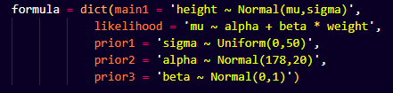
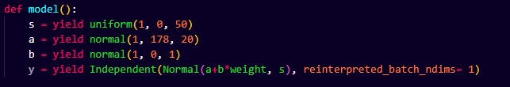
BI V3 : Why
?
Notes:
For
allow higher flexibility
easier maintenance

Slide 18
Validation : testing different models
Continuous variable: Model (model 4.3)
Categorical variable: Model (model 5.9)
Continuous interactions terms (model 8.3)
Binomial (model 11.1)
Binomial with indices (model 11.4)
Poisson (model 11.10)
Negative binomial (model 11.12)
Multinomial (m11.13, m11.14)
Beta binomial (model m12.1)
Zero inflated outcomes (model m12.13, m12.14)
Ordered categorical outcomes
Ordered categorical predictors
Varying interceps (model m13.2)
Varying effects (model m14.1)
Multiple random effects
Networks
Gaussian process

Slide 19
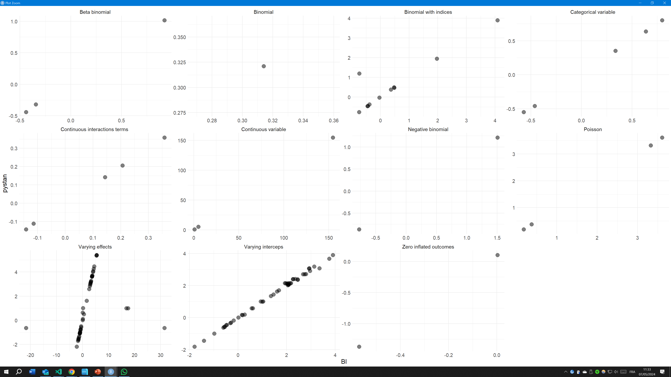
Validation: evaluating models estimations

Slide 20
Validation: Speed comaparison
 | BI v1 | BI v2 (JAX) | BI v3 (JAX) | STAN (with compilation) | STAN (without compilation)
Continuous variable | 5.85 | 2,2 | 1,43
Categorical variable | 4.55 | 1,52 | 1,18 | 12,14 | 0,34
Continuous interactions terms | 7.87 | 1,59 | 1,35 | 12,12 | 0,42
Binomial | 3.35 | 1,43 | 0,85 | 10,69 | 0,49
Binomial with indices | 5.22 | 5,11 | 4,6 | 16,53 | 4,73
Poisson | 11.75 | 4,69 | 0,96 | 14,24 | 0,8
Negative binomial | 4.78 | 4,65 | 0,88 | 12,07 | 1,07
Multinomial | 5.26 | 4,6 |  | 12,79 | 0,59
Beta binomial | 4.26 | 5,61 | 2,63 | 12,89 | 0,49
Negative-binomial
Zero inflated outcomes | 5.2 | 4,9 | 1,47 | 11,52 | 1,32
Varying interceps | 4.96 | 4,88 | 2,44 | 14.19
Varying effects | 13.63 | 8,2 |  | 30.23
Random variables |  |  | 1,98 | 27,55 | 3,25
Gaussian process

Slide 21
Issue
Jax is beta package in version v0.4.26
Jax integration in TensorFlow probability started this year.
Function to transform constraint parameter space lead to loss of JAX speed.
But supposedly this will be updated in un unknown future.

Slide 22

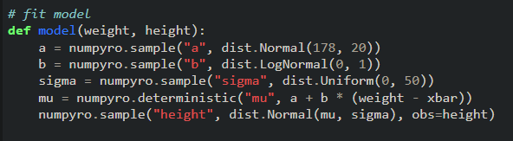
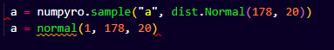
In the meantime…
…A fourth version of the package
NumPyro:
From Pyro team
Bayesian modeling framework
Also use JAX
Beta version: 0.14
Loose the ability of Tensorflow probability to apply Bayesian layers in neural network

Slide 23
Validation: evaluating models estimations

Slide 24
Validation: Speed comaparison
 | BI v1 | BI v2 (JAX) | BI v3 (JAX) | BI v4 (Numpyro) | STAN (with compilation) | STAN (without compilation)
Continuous variable | 5.85 | 2,2 | 1,43
Categorical variable | 4.55 | 1,52 | 1,18 |  | 12,14 | 0,34
Continuous interactions terms | 7.87 | 1,59 | 1,35 |  | 12,12 | 0,42
Binomial | 3.35 | 1,43 | 0,85 |  | 10,69 | 0,49
Binomial with indices | 5.22 | 5,11 | 4,6 |  | 16,53 | 4,73
Poisson | 11.75 | 4,69 | 0,96 |  | 14,24 | 0,8
Negative binomial | 4.78 | 4,65 | 0,88 |  | 12,07 | 1,07
Multinomial | 5.26 | 4,6 |  |  | 12,79 | 0,59
Beta binomial | 4.26 | 5,61 | 2,63 |  | 12,89 | 0,49
Negative-binomial
Zero inflated outcomes | 5.2 | 4,9 | 1,47 |  | 11,52 | 1,32
Varying interceps | 4.96 | 4,88 | 2,44 |  | 14.19
Varying effects | 13.63 | 8,2 |  |  | 30.23
Random variables |  |  | 1,98 |  | 27,55 | 3,25
Gaussian process

Slide 25
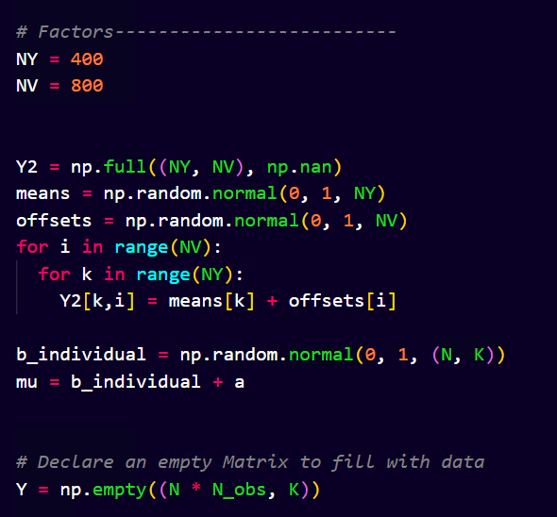
Validation: Speed comparison GPU versus CPU
NY = 4, NV = 8:
BI (GPU) took 35 minutes
BI (CPU) took : 1 seconds
STAN (CPU) took 2.1 secondes
GPU is x XX slower
NY = 40, NV = 80:
BI (GPU) took 35 minutes
BI (CPU) took 21 seconds
STAN (CPU) took 78 seconds
NY = 400, NV = 800:
BI (GPU) took 37min 23 scd
STAN (CPU) took 118 minutes
Simulation of a simple latent variable:

Slide 26
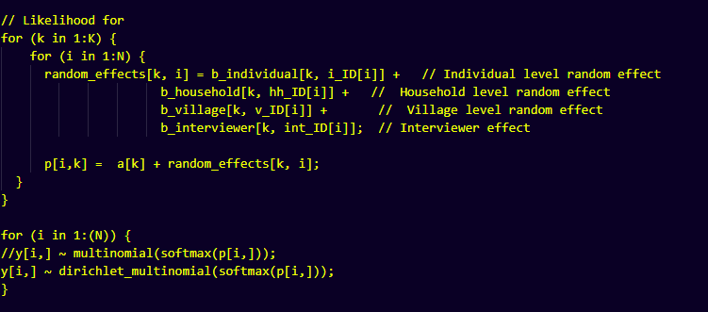
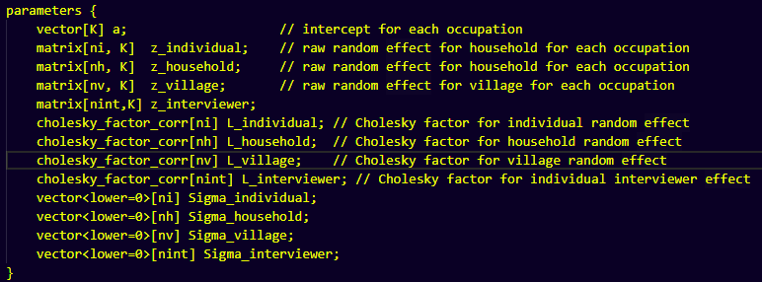
Application: Multinomial model
Data, transformed parameters, parameters to setup.
Random factors need to be setup in different parts of the model.
Models in logical and testable blocks
Run in 1:20 minutes (without parameter space constraint)
Notes:
Do the same but with smaller example

Slide 27
Application: Simulation to validate model

Slide 28
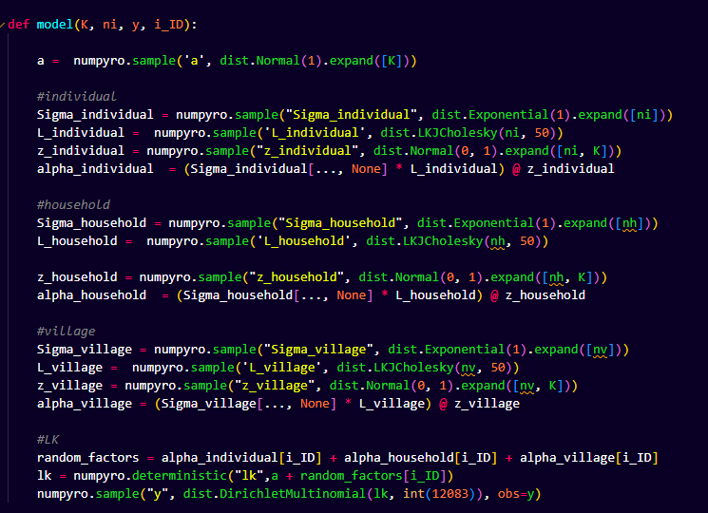
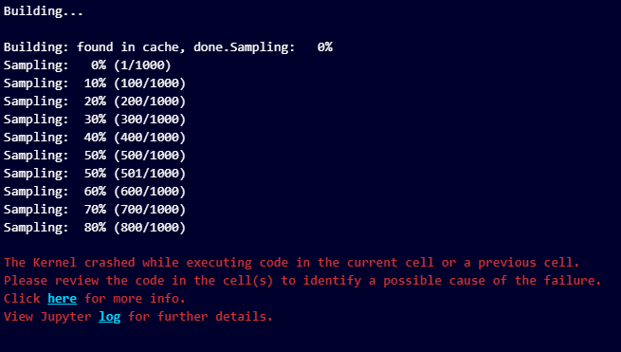
Application: Full model
15 lines
Models in logical and testable blocks
80 lines of codes.
Data, transformed parameters, parameters to setup.
Random factors need to be setup in different parts of the model.
‘Big data’ (NxN matrix, X parameters to estimates Overload of memory
Notes:
Do the same but with smaller example

Slide 29
Application: Issue
GPU memory limits, would have required ~ 24 GB of RAM, equivalent of RTX 3090 (~1200 euros)
Run model on GPU (8GB) with memory deallocation: 38h12 min
CPU and use computer RAM of 63 GB : 24h53 min
Notes:
Do the same but with smaller example

Slide 30
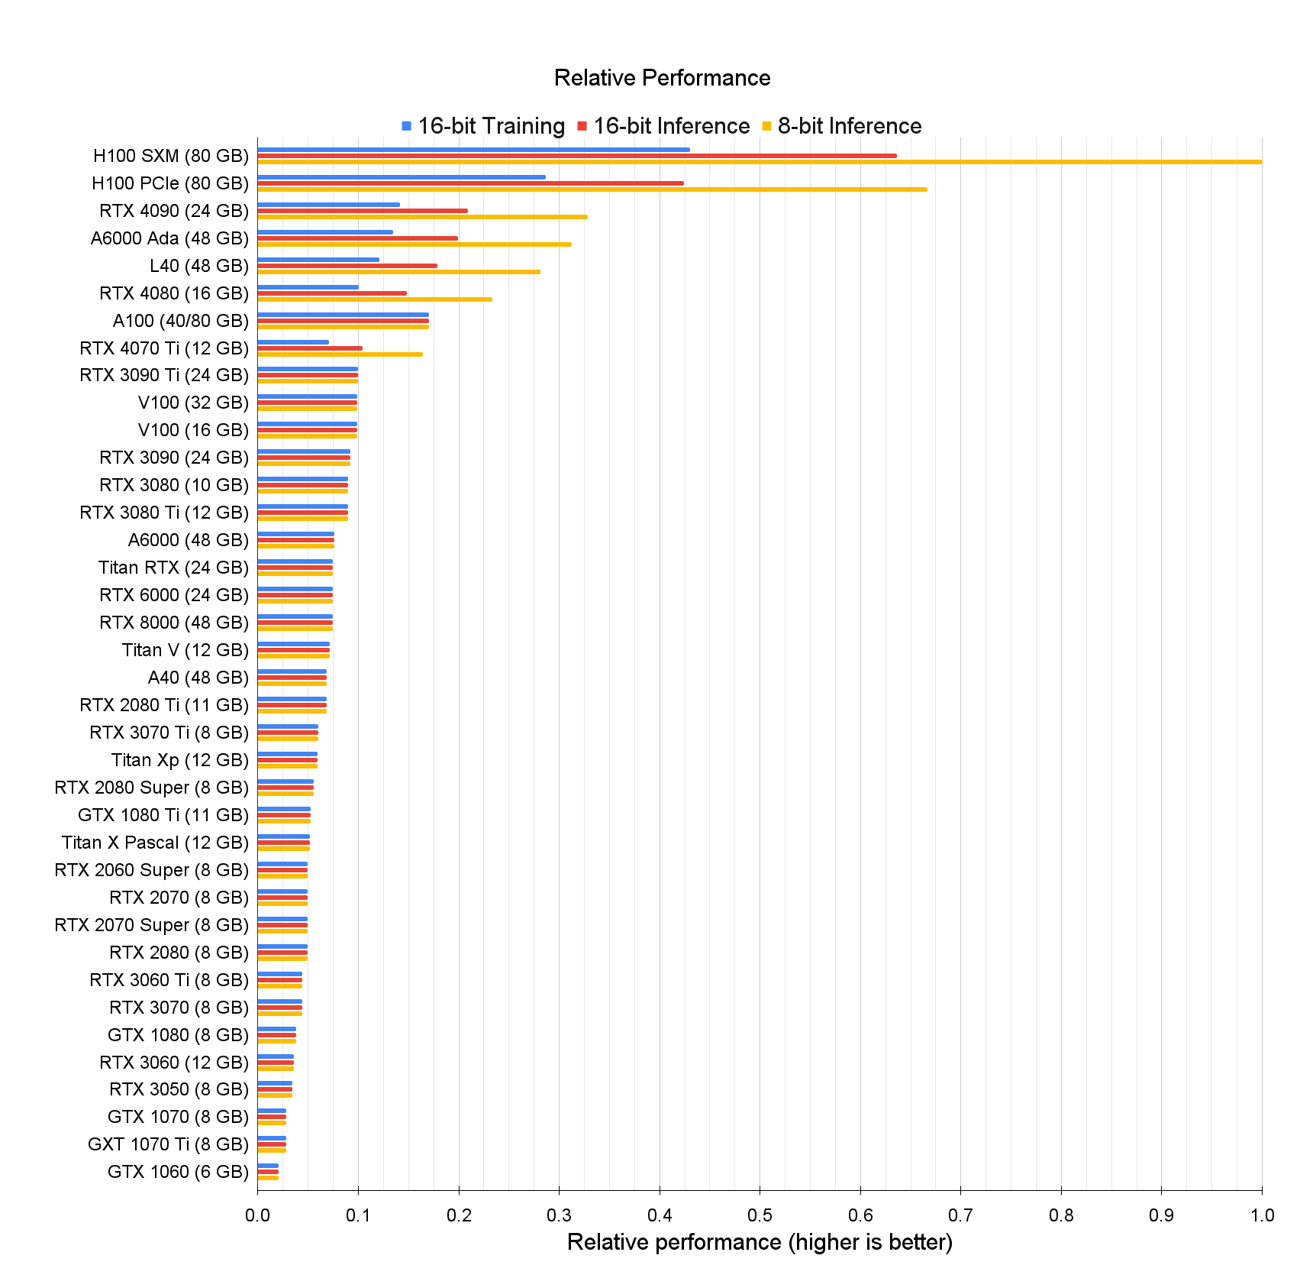
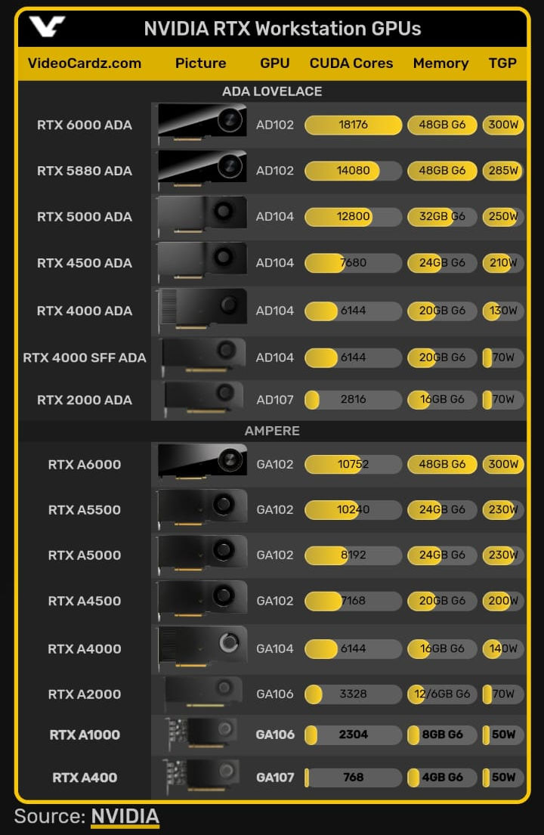
Summary
Price
$33,0001
$28,9992
$1,5993
$6,8004
$29,751
1,0696
$8,240.00 - $10,175.007
6098
1,3299
$8,240.00
Pros:
Shorter model setup
Easily testable
Dynamic programming directly within python
Modular Models
Speed
Scalability
Cross platform
Cons:
GPU memory limitations/price

Slide 31
Future of the project
Redo STRAND with a modular approach
By using the possibility to setup any mathematical operations within the model:
Build JAX functions to compute network measures (nodal, dyadic, global)
Build JAX functions for Multiplex :
Models with multiples likelihoods and parameters influence
JAX functions for multiplex metrics
Collaborative department package:
For simulation models (Automatic Differentiation, Composable Function Transformations)
Agent Based Model?

